Slide 1


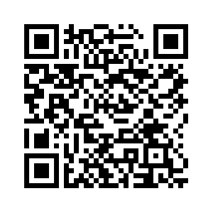

SARTELL AREA
YOUTH BASKETBALL ASSOCIATION
REGISTRATION
**Registration is open for the 2024-2025 Season**
September 18: Last day to register grades 3-5
September 21: Tryouts Girls grade 6 & Boys/Girls grades 4 & 5
SAYBA WINTER CLASSIC
SAYBA will host our 29th Annual SAYBA Winter Classic in January 2025.
**New this year Girls will be on Saturday, January 11th and Boys on Saturday, January 18th.
OUR MISSION
SAYBA will provide programs which develop skilled and competitive basketball players in our community. SAYBA is dedicated to encouraging self-confidence, positive attitude, tea work and good sportsmanship through the game of basketball.

